Slide 1

Optimizing Human Capital to Drive Innovation in Clinical Research

Slide 2
Table of Contents
1.
Company Overview
2.
Business Case
3.
Analysis in Power BI
4.
Assumptions
Scenario Analysis
5.
6.
Recommendations

Slide 3
Company Overview
The company operates in the competitive clinical research and medical sector, where innovation and talent are critical to success.
Key Challenges:
Declining revenues driven by inefficiencies and missed opportunities.
High project obsolescence costs due to delays and incomplete research projects.
Significant opportunity costs linked to employee turnover, dissatisfaction, and retrenchment.
R&D Turnover Concerns:
Turnover in the R&D department is higher than in sales, which is alarming as R&D turnover should typically be lower.
Disrupts critical research, delays project completion, and increases operational costs.
Key Focus Area:
Address turnover, especially among research scientists, where a 5% reduction could lead to significant savings and better project outcomes.
Opportunities for Improvement:
Focus on reducing turnover, improving job satisfaction, and fostering career development.
Enhancing talent retention would boost innovation capacity and help secure the company’s competitive position in the market.
Note: Data used in this project was sourced from publicly available online resources.

Slide 4
Turnover Analysis
R
Business Case
State the Issue/Pain Point or Question to be Addressed: High turnover rates in the R&D department have room for improvement and are causing financial strain. The high turnover rates are causing disruptions to critical research and delays to the projects.
List Supporting Data, Metrics, Charts, and Analysis to Be Gathered and Used:
Turnover Trends : R&D has the highest turnover in absolute terms requiring focus on retention.
New Hire Costs: Each new hire costs $32,500 which includes onboarding, sign-on bonuses, and lost productivity.
Workforce Costs: Total R&D compensation cost is $78.44M
Slides 4 and 5 include important KPIs and charts
Elements to Consider and Incorporate if Relevant: Increasing operational efficiency will reduce disruption in the R&D process. Retention is key and implementing talent retention strategies such as professional development and flexible work arrangements are important.
Estimate the “As-Is” Cost (No Interventions): “As-Is” Cost will be the TCOW of $86.08M including $7.64M in turnover costs.
List and Evaluate Proposed Interventions: Reducing turnover costs to $5.88M lowers TCOW to $84.32M. Retaining experienced employees is critical to minimize long-term costs. In the future we can further improve costs by developing retention programs to reduce turnover. More data is needed to evaluate the performance of the retention initiatives.
Calculate Cost Savings and ROI: Difference (Savings): With a 25% goal it equates to a $1.76M in savings. Current Cost: $86.08M (baseline for evaluation).
ROI: 2.04%, reflecting cost efficiency improvements with targeted retention efforts. A range of 15%-25% turnover rate was created with a conservative target rate of 25%. More details shown on slide 9.
25% Goal: 2.04% ROI with $1.76M savings
20% Goal: 3.40% ROI with $2.93M savings
15% Goal: 5.29% ROI with $4.55M savings

Slide 5
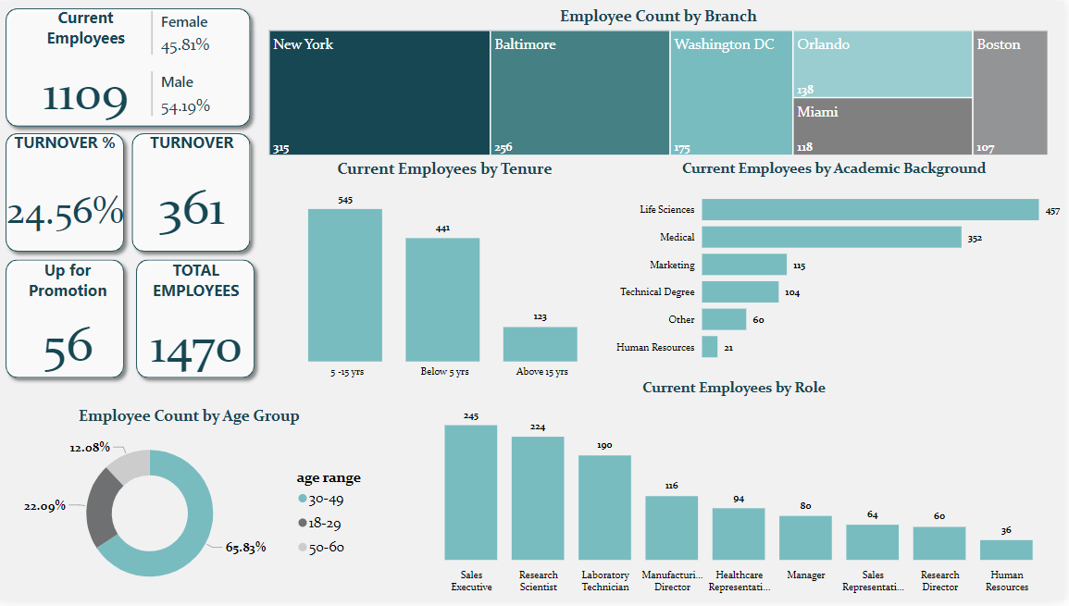

Slide 6
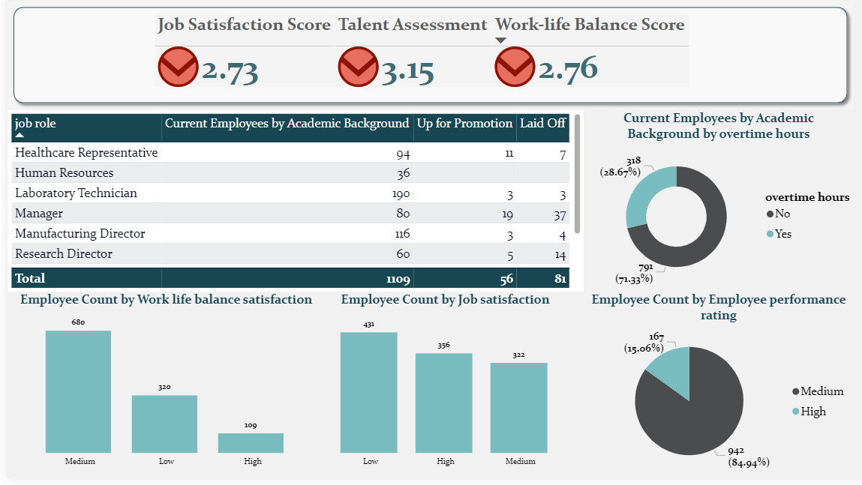

Slide 7
Turnover Analysis
R
Assumptions
Lower Turnover Rate:
R&D has generally lower turnover compared to the Sales department.
Average Compensation by Experience in the R&D wing:
Below 5 years: $80K
5–15 years: $120K
Over 15 years: $160K
New Hire Costs:
Sign-on Bonus & RSU: $25K
Onboarding & Training: $5K
Productivity Impact: $2.5K
Productivity Insights:
New employees experience a 25% productivity reduction in their first month.

Slide 8
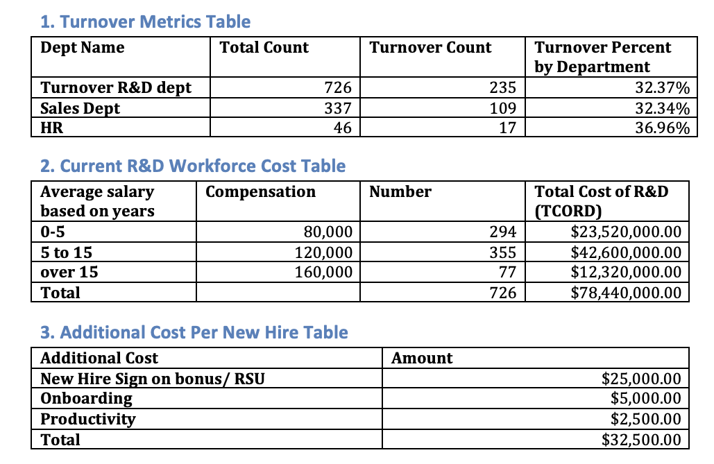
Scenario Analysis Part 1
Turnover Metrics and Analysis
High Turnover in Key Departments:
R&D Department: 32.37% turnover rate (235 out of 726 employees).
Sales Department: 32.34% turnover rate (109 out of 337 employees).
HR Department: 36.96% turnover rate (17 out of 46 employees).
Critical Focus Area:
The R&D department has the highest employee count and significant turnover impact.
Current Workforce Cost Insights
Total R&D Cost: $78.44M annually for 726 employees.
Additional Cost Per New Hire: $32,500 (sign-on bonus, onboarding, and productivity loss).

Slide 9
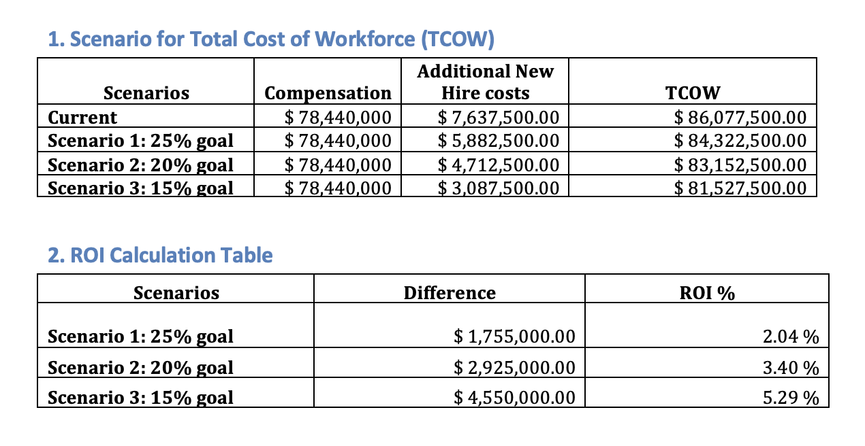
Scenario Analysis Part 2
Cost of Turnover Analysis
Scenarios for Additional Costs:
Current Turnover (32.37%): $7.64M in new hire costs.
Scenario 1 (25% goal): $5.88M, reducing costs by $1.76M.
Scenario 2 (20% goal): $4.71M, saving $2.93M.
Scenario 3 (15% goal): $3.09M, saving $4.55M.
Return on Investment (ROI)
ROI for Turnover Reduction Goals:
25% Goal: 2.04% ROI with $1.76M savings.
20% Goal: 3.40% ROI with $2.93M savings.
15% Goal: 5.29% ROI with $4.55M savings.
Key Takeaway from ROI Analysis:
Reducing turnover, especially in critical departments like R&D, can lead to substantial cost savings, with up to $4.55M saved at a 15% turnover goal, achieving the highest ROI of 5.29%. Proactive retention strategies are essential to optimize workforce costs and improve organizational stability.

Slide 10
Turnover Analysis
R
Recommendations
Focus on R&D Retention: Address high turnover (235 employees) with professional development, flexible work options, and recognition programs (promotion).
Reduce Turnover: Mitigate the high turnover rate through improved onboarding, career growth, and engagement strategies.
Boosting Productivity Through Balance: A Flexible Work-Life Program with Adjustable Hours and Hybrid Options for Well-being and Sustainable Success
Retain Mid-Tenure Employees: Prioritize retention of employees with 5-15 years of experience, contributing $42.6M in workforce costs.
Optimize Hiring Costs: Reduce the $32,500 per hire expense by streamlining recruitment and onboarding.
Achieve Cost Savings: Target a 25% reduction in turnover costs to save $1.76M, reducing TCOW to $84.32M.

